Slide 1
Phase 1:
Hardware build of the robot
Progress - 09.09.2019
Team:
ANFM. Begum - SEU/IS/13/EG/002
GSU. Ahmadh - SEU/IS/13/EG/011
IIS. Prema Sri - SEU/IS/13/EG/032

Slide 2
Last meeting:
We agreed to work on finishing the robot hardware as it is important to continue other parts of the project.
We managed to finish the robot skeleton and making wheel alignments with the motor. Due to exams, we didn’t get to work on motor controlling and the electronics of it.

Slide 3
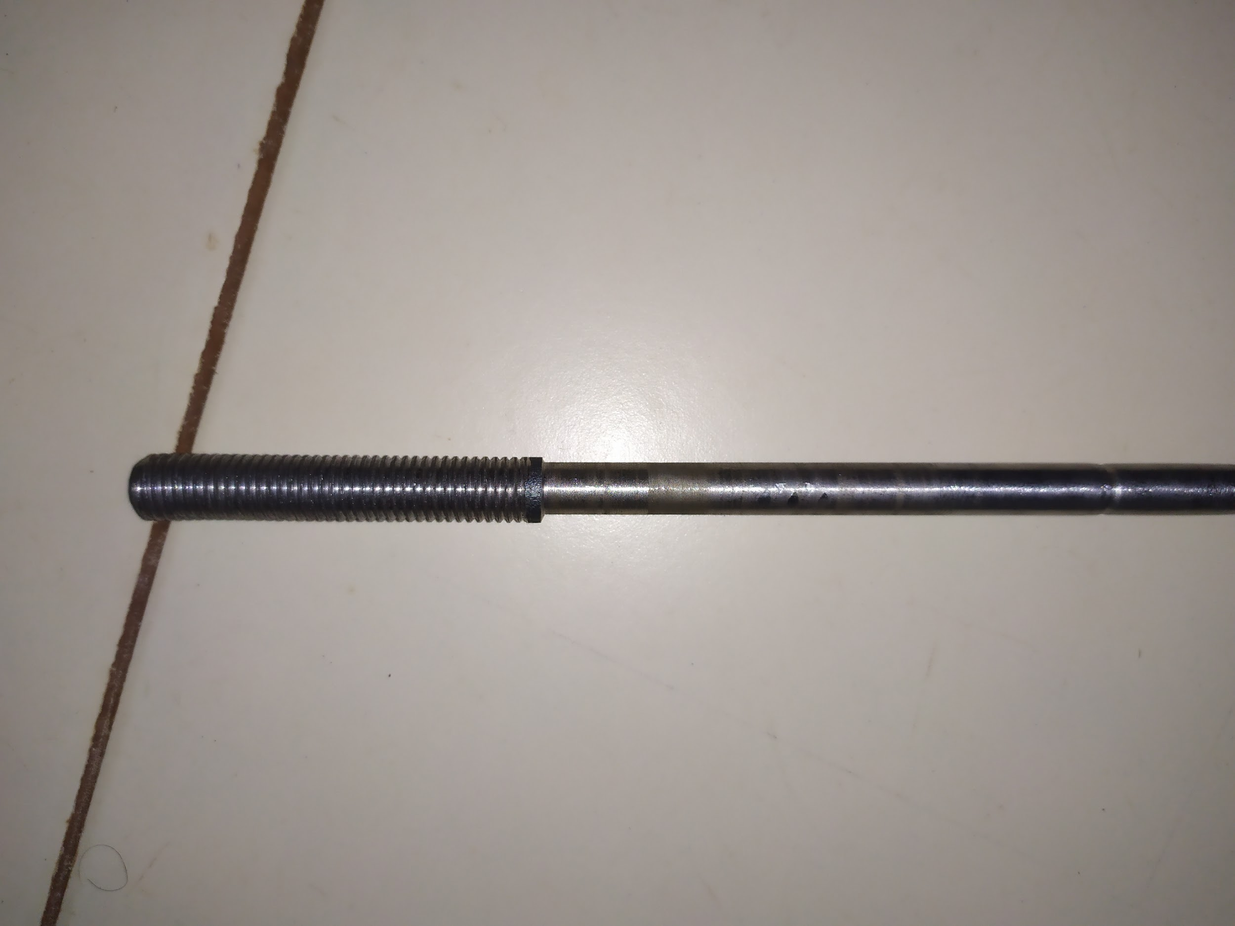
Robot building
Building shaft and coupler for wheel-motor connection

Slide 4
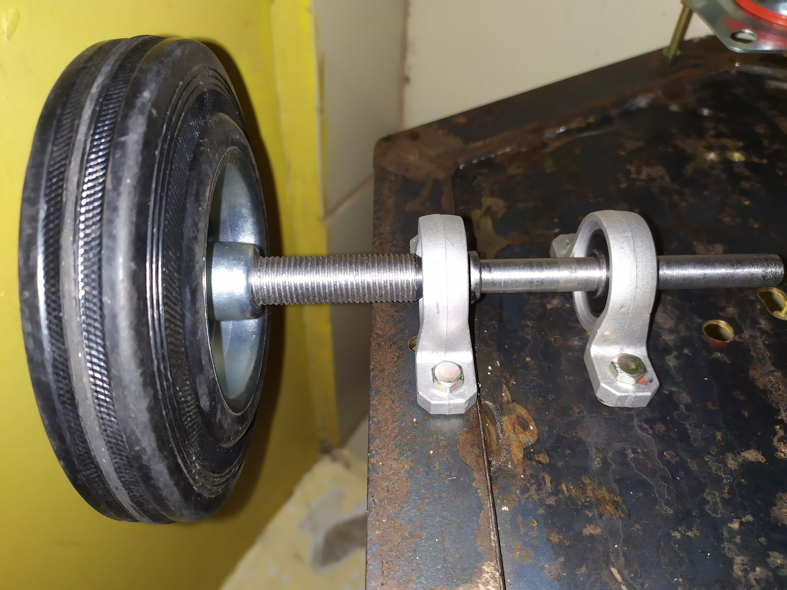
Robot building
2. Selection and purchasing of the wheel and connection
3. Adding pair of bearings for the shaft alignment and support
4. Mounting them to the robot body

Slide 5
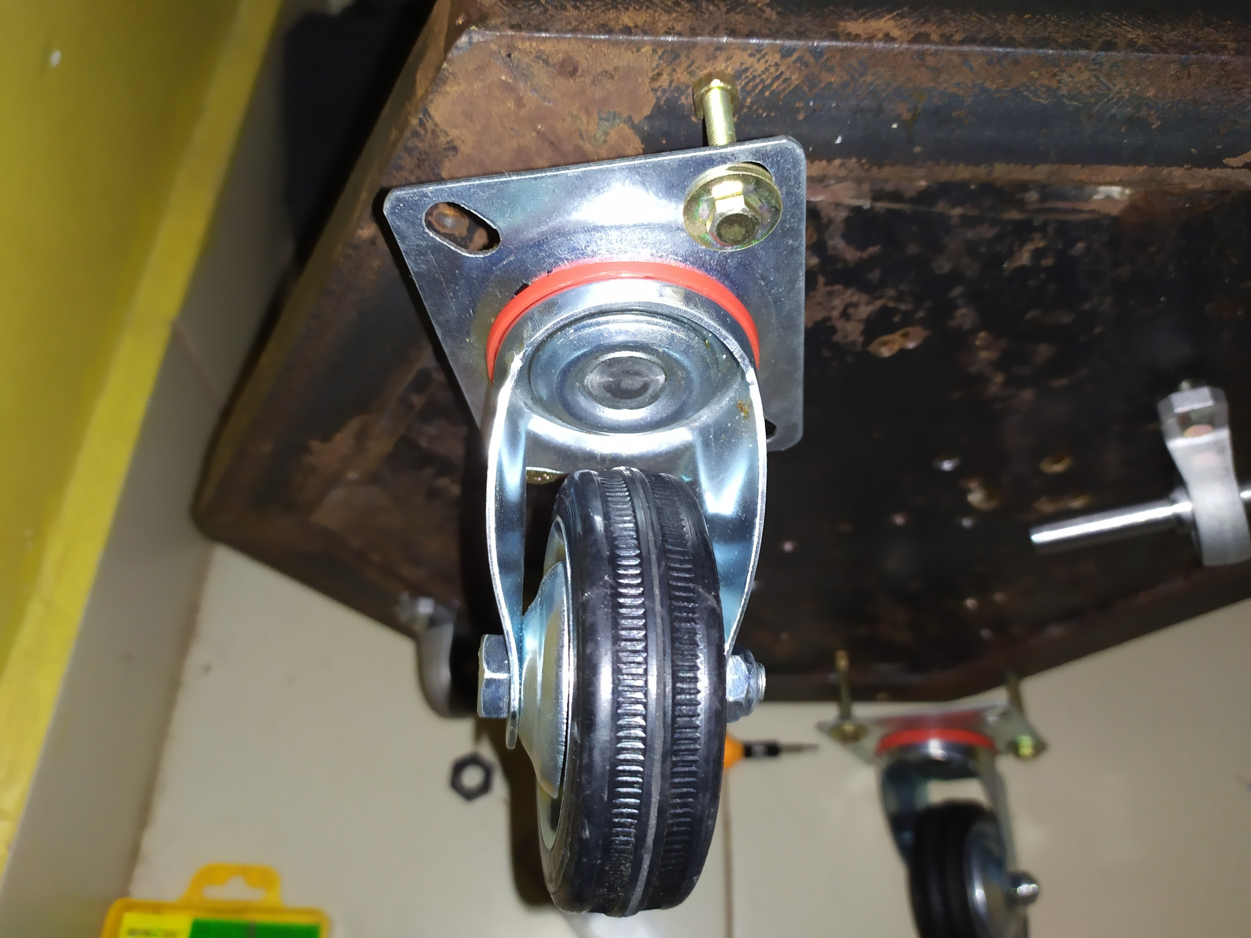
Robot building
5. Caster Wheel selection and purchasing
6. Mounting the wheels to the body with spacer nuts to align with the wheel height

Slide 6
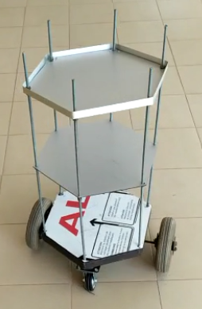
Robot building
7. Connecting the entire skeleton and completing the body
Note: Image here is the initial built of the robot. Later we did motor upgrade and wheel changes, unable to get the final image.

Slide 7
Next progress:
Already gathered robot electronics will be connected to the body and we will make the controls.
By having a wireless control to the robot, any movement commands sent to the robot will be programmatically analyzed and the motor control will be done. (As in our entire system, navigation system will send the movement commands and the robot will only receive which directing and how long it should move. All other coordinate process is to be handled by our external navigation system

Slide 8
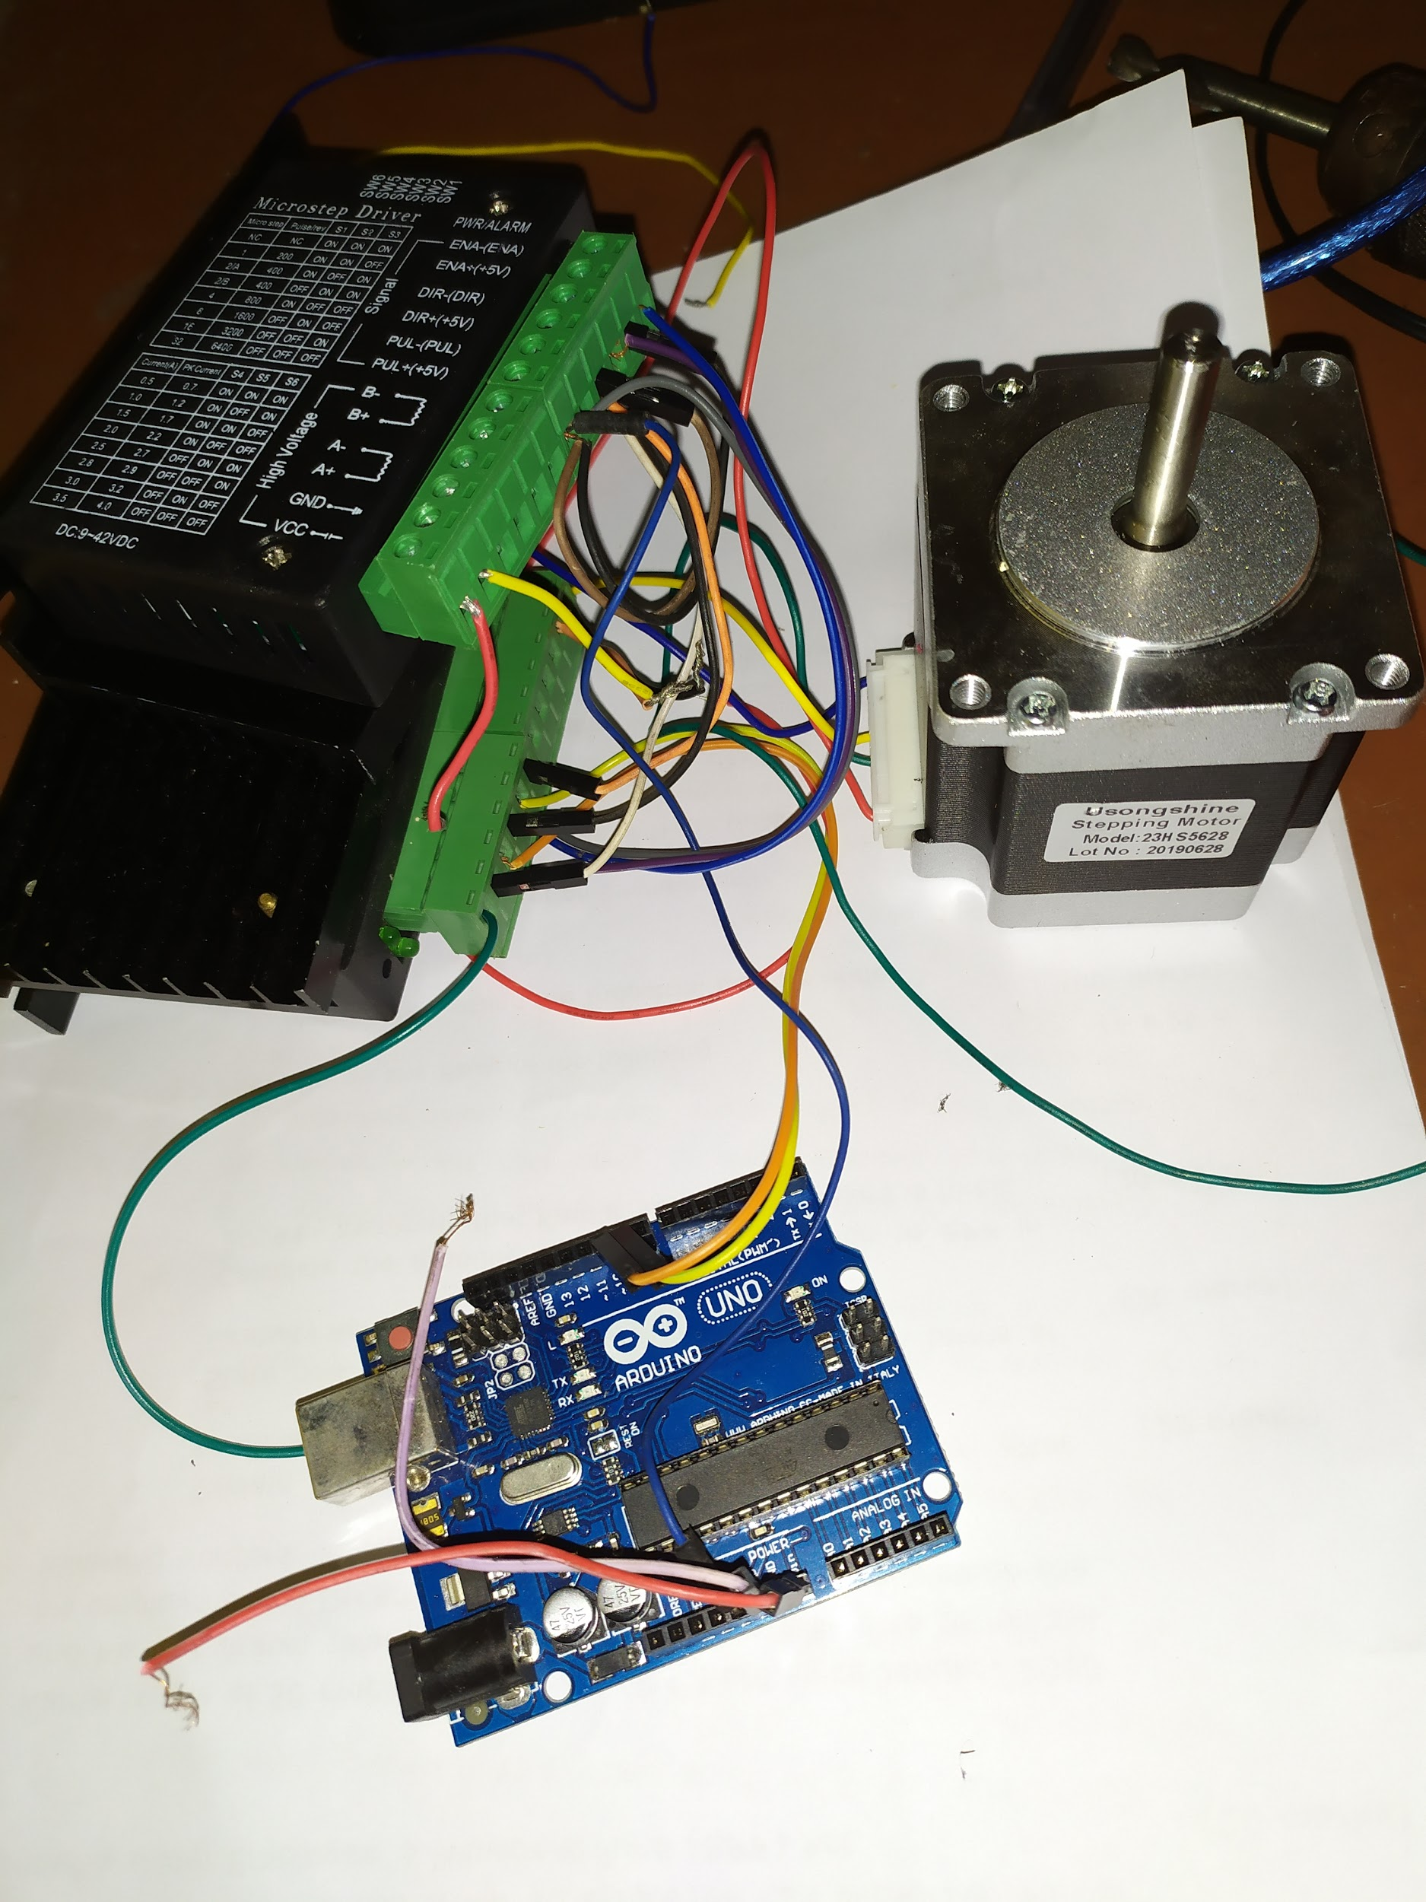
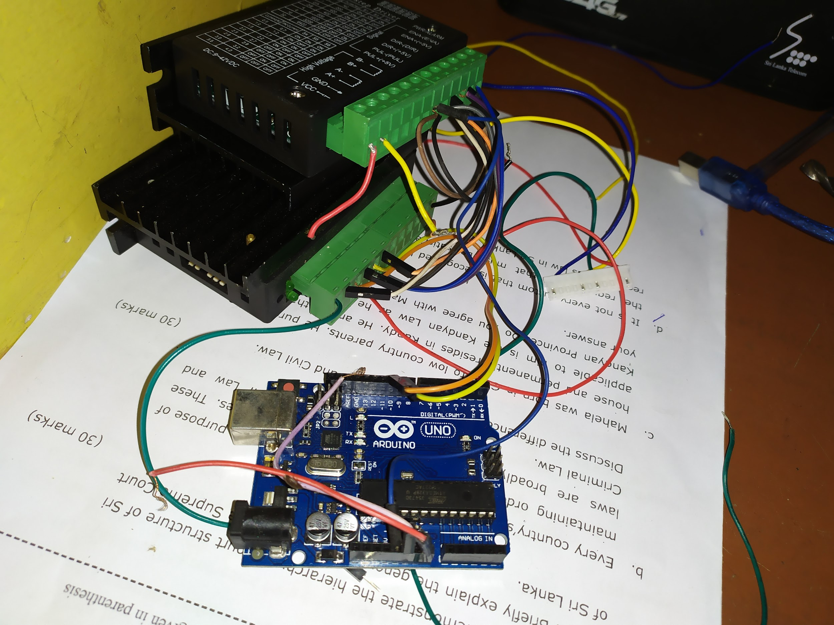
Some interim progress on the electronics

Slide 9
Thank You

